Slide 1

Optimize the genome Optimize the problem
Chiabodo Alessandro
S309234

Slide 2
Why?
How?
Too difficult to optimize the training for «harder» instances of the problem
Trial and error starting from some «sub-optimal» solution
Too many calls to the fitness function even with easier problems
Adding more parameters to the individual’s genome
The standard genome was hard to optimize following only the fitness
Let the population find the optimal genotype lenght

Slide 3
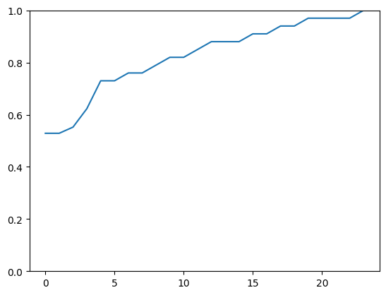
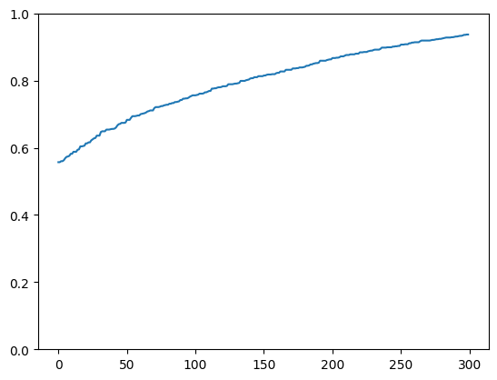
Black Box Training
Same training technique
Same fitness function
Comparison over fitness and generations (max 300)
400 Pattern-based Agents
2100 fitness calls
1200 Agents
300K fitness calls
Ends after 24 generations
Stopped after 300 generation

Slide 4
Standard Genome
Features:
Standard genome
Phenotype and genotype match
Advantages:
Easier to define and mutate / cross over
More generic
Disadvantages:
Higher chance of finding mesas
Difficult to optimize with “hard” fitness landscapes

Slide 5
Some Code
def set_genome(self,genome_size : int) -> 'Agent’: self.genome = [random.uniform(0, 1) < 0.5 for _ in range(1000)]
return self
def mutation(self,mutation_rate : float = None) -> 'Agent’:
mask = [random.uniform(0, 1) < mutation_rate for _ in range(len(self.genome))]
self.genome = [a ^ b for a, b in zip(self.genome, mask)]
return self
def one_cut_crossover(self,other : 'Agent') -> 'Agent': n = random.randint(0, len(self.genome)-1)
self.genome[n:] = other.genome[n:]
return self

Slide 6

Pattern-based Genome
Features:
Shorter genome (N bits << 1000)
Phenotype given by repetition of the genome
Advantages:
Easier to optimize even in “hard” fitness landscapes
Less randomness in the phenotype
Disadvantages:
Non-recurring problems cannot be solved well
Mutation and crossover more difficult to implement
Pattern

Slide 7
Some Code
def set_genome(self,genome_size : int):
self.pattern_size = random.randint(genome_size//50,genome_size//2)
self.pattern = [random.uniform(0, 1) < 0.5 for _ in range(self.pattern_size)]
self.genome = list(chain.from_iterable(
[self.pattern for _ in range(self.genome_size//self.pattern_size + 1)]))
self.genome = self.genome[:self.genome_size]
def mutation(self,mutation_rate : float):
if random.random() < mutation_rate:
adding = random.choice([-1, 1])
if adding == -1 and self.pattern_size > 1:
self.pattern_size -= 1
self.pattern = self.pattern[:-1]
else:
temp = random.choices([0, 1], k = adding)
self.pattern_size += adding
self.pattern += temp for (i,state) in enumerate(self.pattern):
if random.random() < mutation_rate:
self.pattern[i] = not state
self.generate_genome()

Slide 8

Further improvements
Adds agents with bigger patterns
Mutate into “standard” genome after N static generations
Mix both agents in the population

Slide 9

Thanks for the attention!
For full-code about Pattern-Based Agents https://github.com/AChiabodo/compIntelligence

